Slide 1

Vehicle Loan
Prediction
GROUP 3
Mrunalini Devineni
Sara Sanchez
Aihan Liu
GITHUB LINK

Slide 2
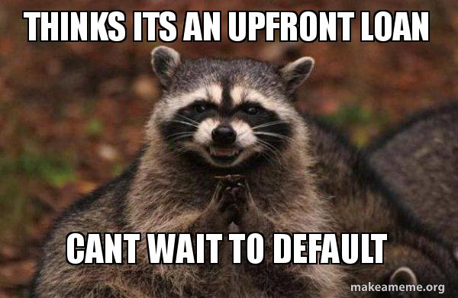
Introduction
Financial institutions incur significant losses due to the default of Vehicle Loans. This has led to the constricting of vehicle loan underwriting and increased vehicle loan rejection rates
A Credit Score: good or bad.
Forecasted probability of default
Notes:
Financial institutions incur significant losses due to the default of vehicle loans.
A Credit Score is a statistical model that classifies a client according to their risk profile in one of the following categories: good or bad.
Forecasted probability of default based on client’s profile and classified borrowers according credit score.

Slide 3

Want to get a car??

Slide 4
Want to get a car??
Apply to car loan through the bank institution
Bank decides to give you a loan! But what factors affect their decision ?is it a YAY or NAY!!
You repay the loan over monthly installments including interest
Liquid Assets
Debt to Income Ratio
Credit score
Many more
collateral
Income

Slide 5
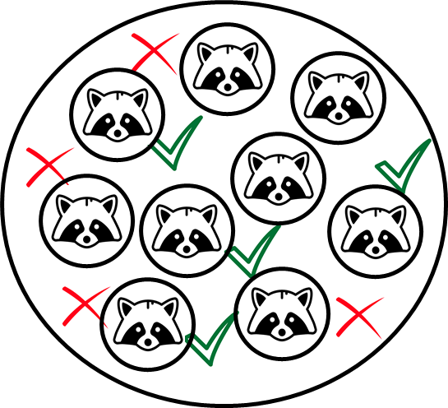
Score
Allows forecasting the probability of default based on the client's profile information.
Goal: Distinguish between good and bad profiles.

Slide 6
Dataset
L&T company data set (kaggle)
Loanee Information
(Demographic data like age, Identity proof etc.)
Loan Information
(Disbursal details, loan to value ratio etc.)
Bureau data & history
(Bureau score, number of active accounts, the status of other loans, credit history etc.)
40 variables
233 154 observations

Slide 7
SMART Question: What are the features that influence loan default based on customer’s profile information?

Slide 8
Roadmap
1.collected the dataset from Kaggle
3.EDA(Exploratory Data Analysis)
5.Model Training and saving them using pickle
7.Integrate the models and EDA to the GUI (pyqt5)
1
3
5
17
1
2
4
6
2.Loaded the dataset and performed necessary cleaning on it
4.Data Preprocessing-
scale,Feature Engineering,Data Balancing
6.Prediction and evaluation of Target

Slide 9
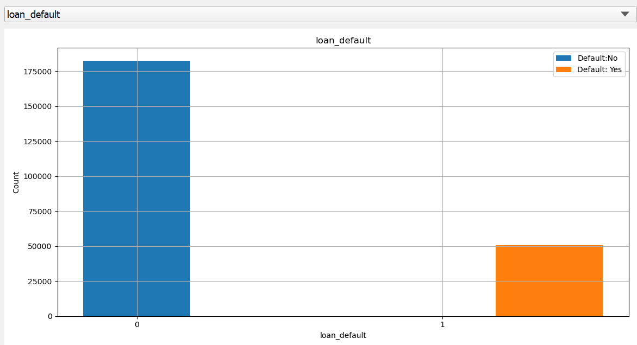
Exploratory Data Analysis (EDA)
Clearly the graph proves the problem statement that the number of “No’s” to loan default is much higher than the “Yes”, the data is unbalance in this case.
Apply SMOTE method to balance dataset.

Slide 10
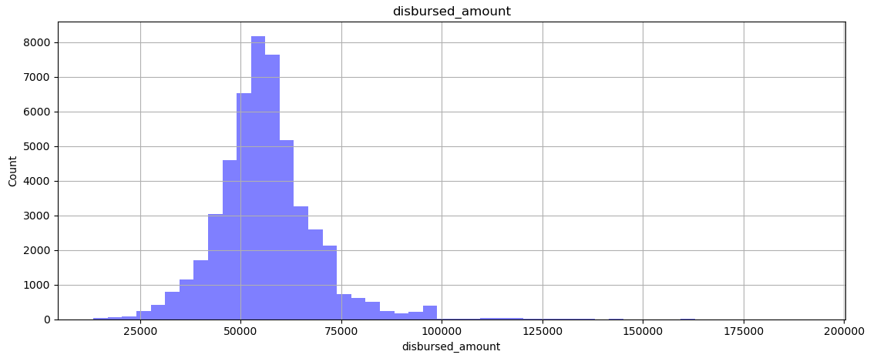
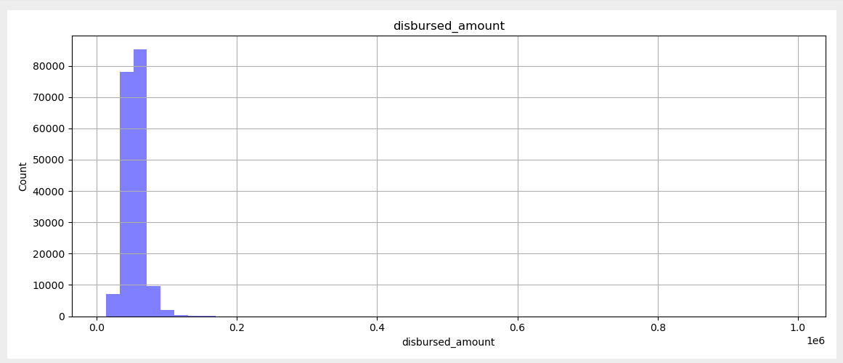
Disbursed Amount
Loan default considered to be “yes”
Loan default considered to be “No”

Slide 11
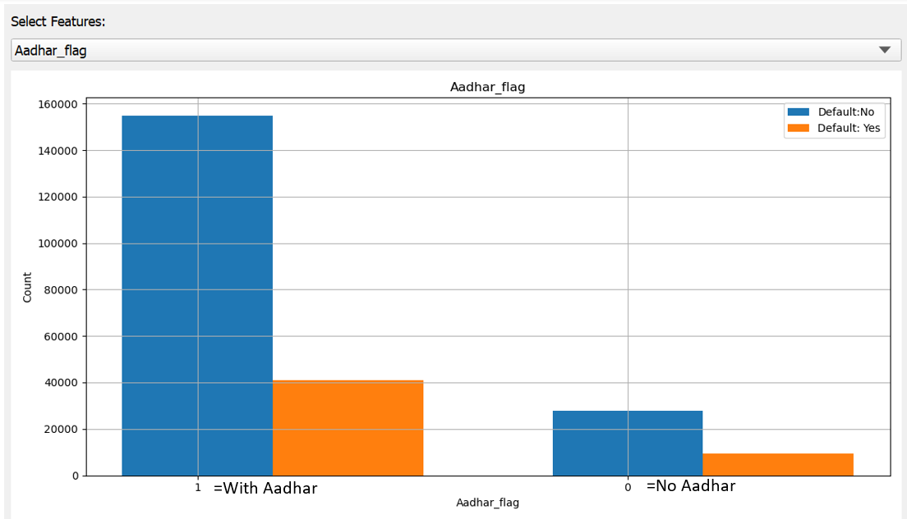
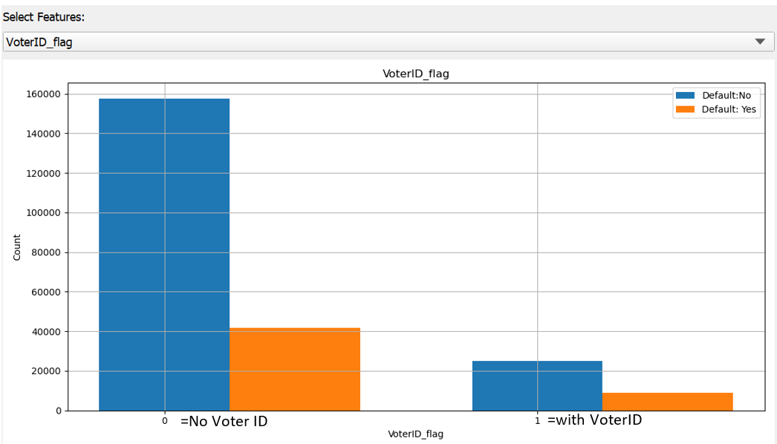
Aadhar and Voter ID
The count of people having Aadhar Card as address proof and not having it.
The count of people having Voter ID as address proof and not having it

Slide 12
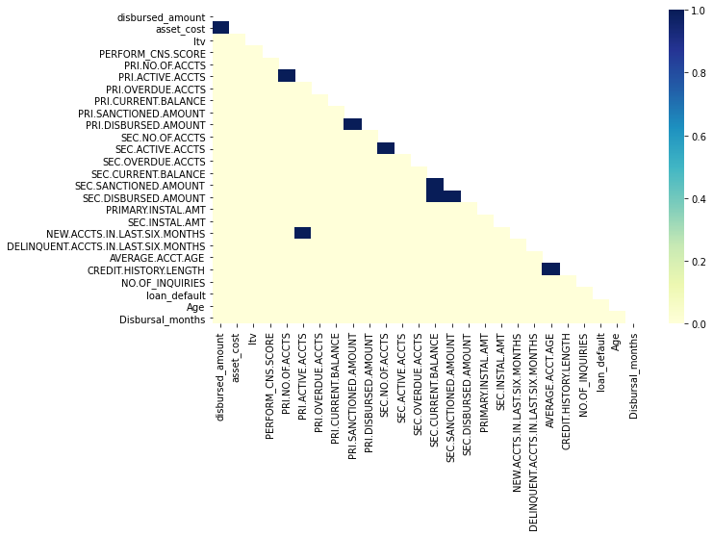
Relationship between variables
Correlated features:
Asset cost<->Disbursed amount
Sanctioned Amount<->Disbursed amount
Credit history length<-> avg account age

Slide 13
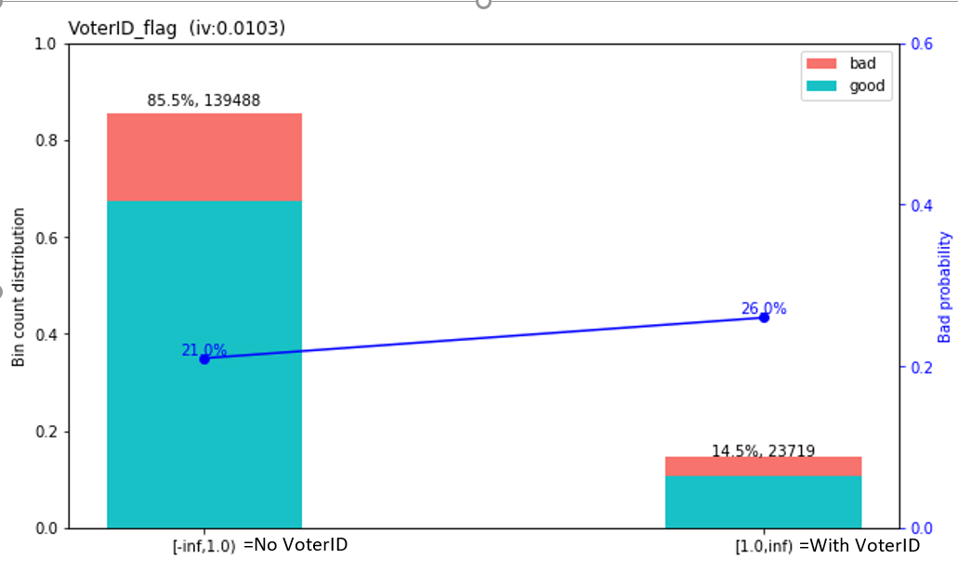
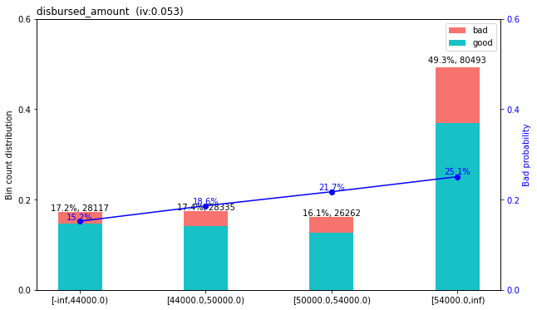
Weight of Evidence
These two variables can distinguish between profiles because, as we can see from the default rate, this is different for those who have or do not have a voter ID and those who have different disbursed amounts.

Slide 14
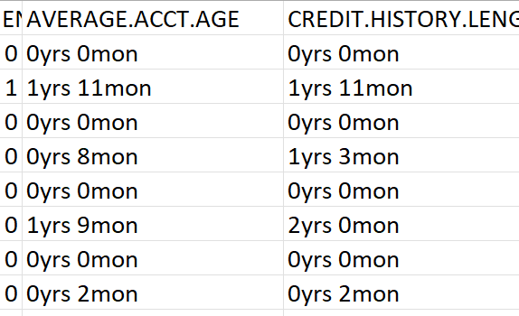
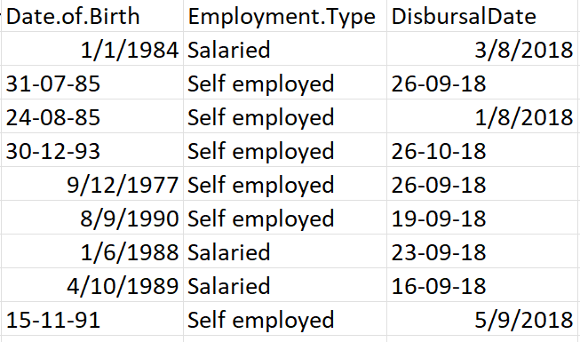
Data Preprocessing
Dropped the missing values
Formatted date
Calculated Age and Disbursal months from the existing features
Feature elimination
Feature Engineering
Created buckets to reduce the number of categories
Balanced the data with hyperparameter of each model

Slide 15

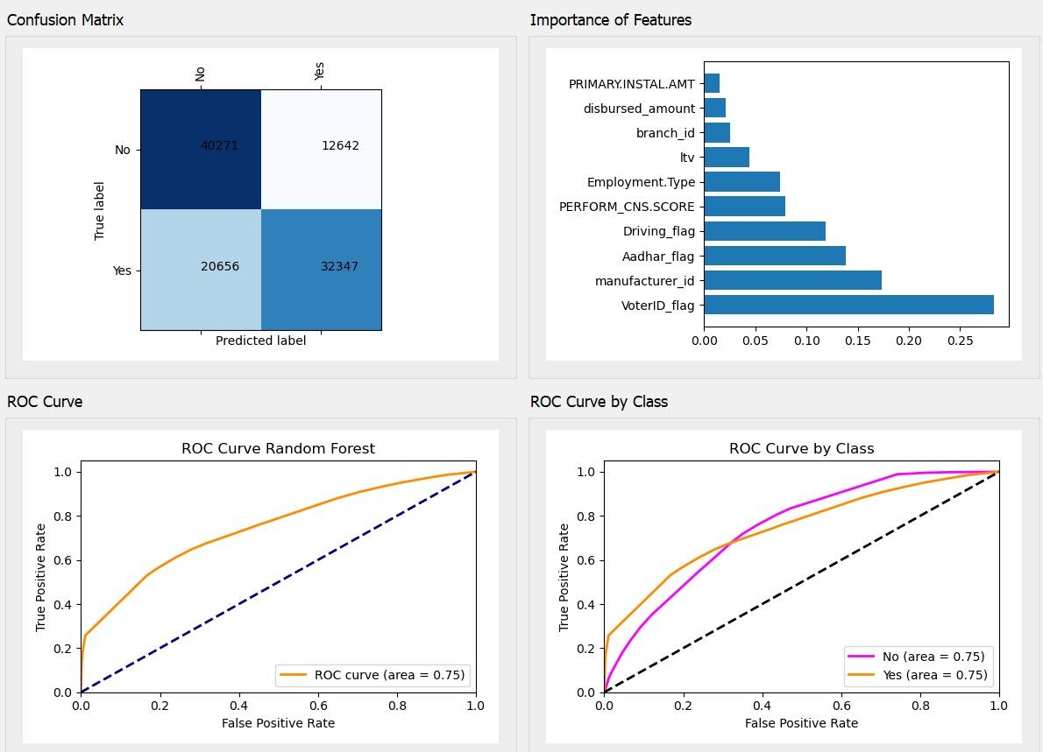
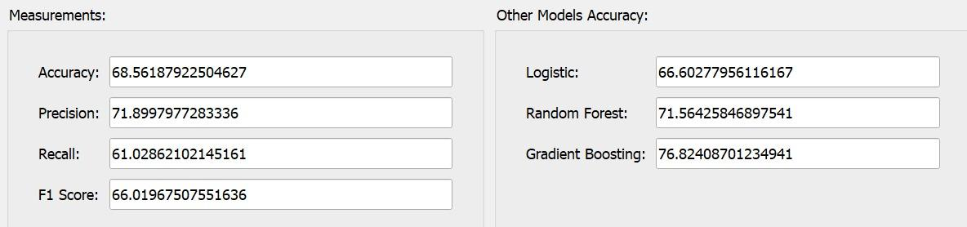
Decision Tree

Slide 16
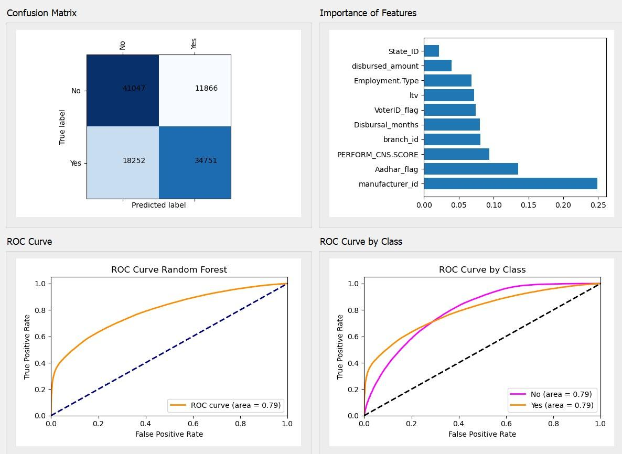
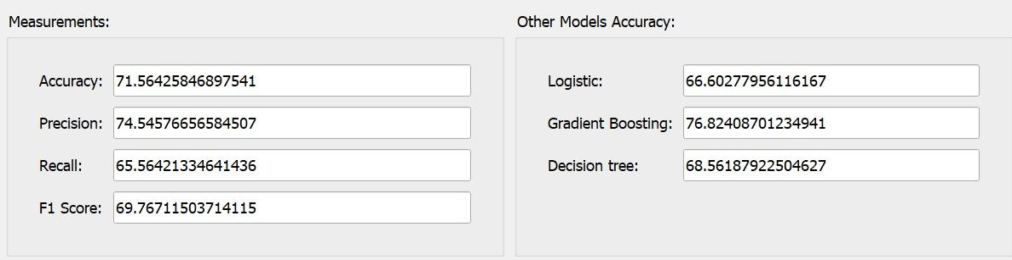
Random Forest

Slide 17
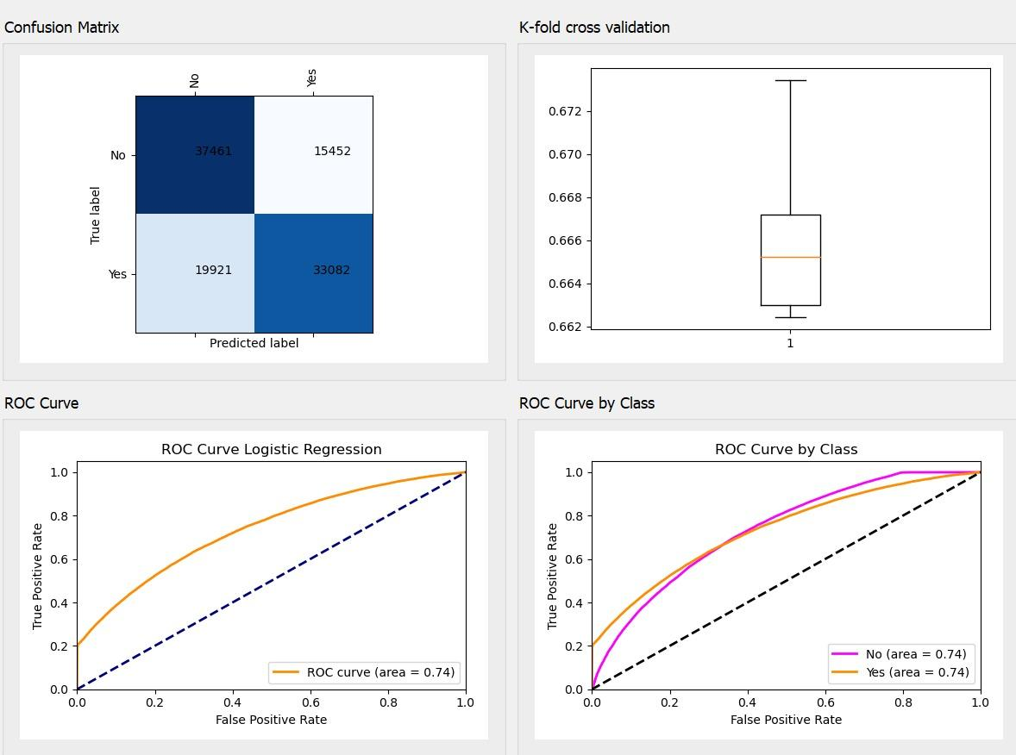
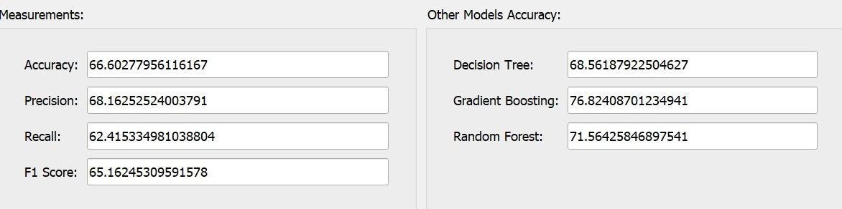
Logistic Regression

Slide 18
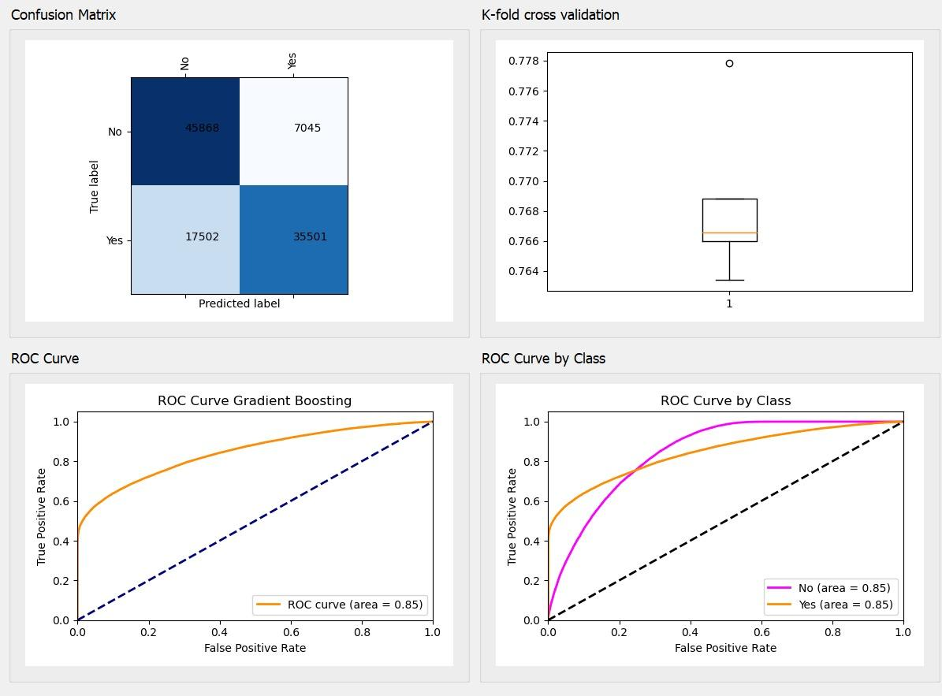
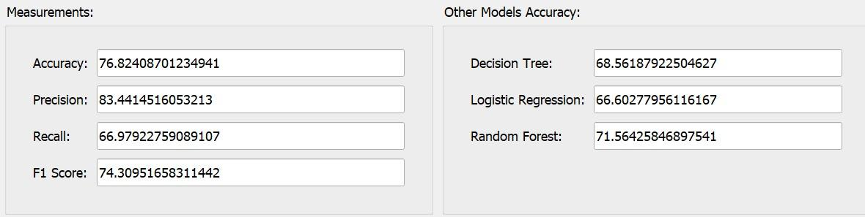
Gradient Boosting

Slide 19
and table to compare Models
Metrics | Random Forest | Logistic Regression | Gradient Boosting | Decision Tree
Accuracy | 71.56% | 66.60% | 76.82% | 68.56%
Precision | 74.54% | 68.16% | 83.44% | 71.89%
Recall | 65.56% | 62.41% | 66.97% | 61.02%
F-1 score | 69.76% | 65.16% | 74.30% | 66.01%

Slide 20
Conclusion:
The features that most affect the loan default are: supperlier_id, ltv, disbursed_amont, bureau score, number of enquiries.
The model we trained that have highest accuracy is Gradient boosting, however it has a lowest recall.
Other work that may improve the accuracy of this dataset is to apply PCA or other feature selection techniques. We can also use other ensemble method to get a better results. .

Slide 21
THANKS!
Any questions????

